Slide 1
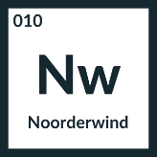

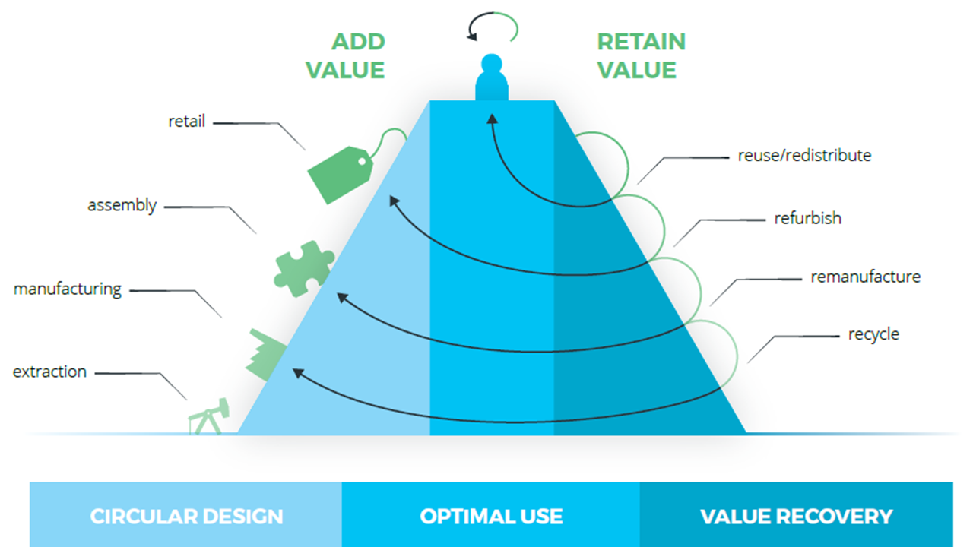
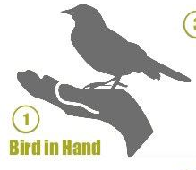
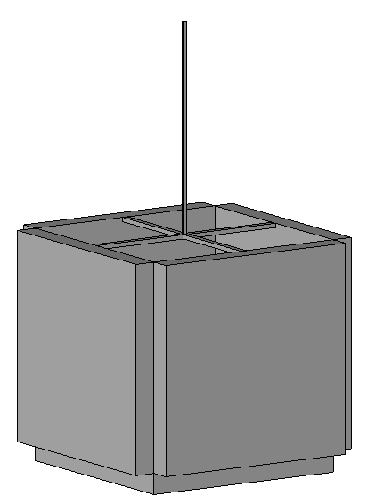



Idea development
Idea description: A lamp made from pieces from the doorlock, hinges and new bolts.
Can this idea be realized locally? How? Yes, it only need new connections through add new bolts.
Parts and/or materials used: pieces form doorlock, hinges & new bolts.
Where is this idea located on the value pyramid? Reuse / remanufacture.
New function of the idea: make a lamp that can be easy put in and out the in apart pieces that can reused again.
Are the things, needed to accomplish this, within your reach? Yes, new bolts.
Draw idea:
hinges
lamp
new bolts
door lock
Some of the images used on this workshop come from Circle-e
This work is licensed under the Creative Commons Attribution-Share Alike 3.0 Unported License

